Slide 1
Top Skills in Demand for Developers
Nguyen Dang Khoa | March 11, 2022

Slide 2
Outline
Executive Summary Introduction Methodology Results
Visualization – Charts Dashboard
Discussion
Findings & Implications Conclusion

Slide 3
EXECUTIVE SUMMARY
1
2
3
4
The Dataset
The Methods
The Findings
The Implications
The report presents key highlights and trends from the annual Stack Overflow Dataset 2019 – a questionnaire collected from developers and coders worldwide.
Through various methods, the most important trends were identified. Webscraping, SQL database queries, a Python analysis and IBM Cognos Dashboards were used and applied.
As the fastest growing programming language, it is becoming increasingly important to acquire Python skills. However, Javascript remains the most popular language. Among the databases, MongoDB is the fastest growing.
If developers are aiming for higher earnings, it may be worthwhile to focus on Python and JavaScript, and further training in MongoDb.
Job offers will increase here.
It should be taken into account that top skills in demand may change again in the coming years.

Slide 4
INTRODUCTION
The report presents the trends and insights from the 2019 Stack Overflow Dataset (see overflow stack, 2019).
1
What is the topic?
The report 'is the largest and most comprehensive survey of people who code around the world.' (see stack overflow, 2019). The survey covers everything from developers’ favorite technologies to their job preferences.
2
What is it about?
Using various methods, the most important trends for developers were identified.
What was the goal?
3

Slide 5
METHODOLOGY
Webscraping
SQL Database Querys
Python Analysis
IBM Cognos
1
2
3
4
Extracting information via Webscraping of most paid progamming languages
Executing SQL Database Queries to call up information of the Stack Overflow Dataset 2019
Performing Python Analysis to gain further information of the Stack Overflow Dataset 2019
Displaying Data of Stack Overflow Dataset 2019 in different dashboards

Slide 6
1
Sociodemographic results
Nearly 90 000 participants
93.7 % male, 6.3 % female Average age: 30.7 years
Most respondents from: USA, followed by United Kingdom, Germany & India
2
Which is the most frequent developer type?
3
What are the language trends & implications?
Results
4
What are the database trends & implications?

Slide 7
The most frequent developer types in 2019
60 %
40 %
20 %
0 %
Full-Stack
Back-End
Front-End
Mobile

Slide 8
Programming Language Trends
Top 5 Programming Languages in the Current Year
Top 5 Programming Languages in the Next Year
JavaScript
JavaScript
HTML/CSS
Python
SQL
HTML/CSS
Bash/Shell/PowerShell
SQL
Python
TypeScript
0
25.000.000
50.000.000
75.000.000
100.000.000
125.000.000
0
25.000.000 50.000.000 75.000.000 100.000.000
Number of respondents who worked with the language
Number of respondents who want to work with the language

Slide 9
PROGRAMMING LANGUAGE TRENDS – FINDINGS & IMPLICATIONS
JavaScript as most popular language
JavaScript is the most popular language in 2019 and remains the most popular language in 2020.
Keep JavaScript Sills updated
As Javascript remains in demand, developers should continue to keep their Java skills up to date and invest in learning the language.
F
I
Python as the fastest growing language
While HTML/CSS was the second most popular programming language in 2019, Python replaces it and becomes the second most popular language in 2020. SQL drops one place further down in 2022 and Bash/Shell/PowerShell are no longer among the top 5 most popular languages in 2020.
Focus on Python
To keep up with the demands, developers should rely on Python and put more effort into learning the language.
F
I

Slide 10
Database Trends
Top 5 Databases in den Current Year
Top 5 Databases in the Next Year
MySQL
PostgreSQL
PostgreSQL
MongoDB
Microsoft SQL
Redis
SQLite
MySQL
MongoDB
Elasticsearch
0 25.000.000 50.000.000 75.000.000
Number of respondents who worked with the database
0 20.000.000 40.000.000 60.000.000
Number of respondents who want to work with the database

Slide 11
DATABASE TRENDS – FINDINGS & IMPLICATIONS
MySQL less important, PostgreSQL grows
From 2019 to 2020, MySQL drops from first to fourth place among popular databases. Instead, PostgreSQL takes first place in 2020.
Keep PostgreSQL updated
Since PostgreSQL 2020 is still the most popular database, developers should know how to work with this database and should update their knowledge.
The focus should no longer be on MySQL.
F
I
MongoDB as fastest growing database
While MongoDb was in fourth place among popular databases in 2019, it takes second place in 2020, growing rapidly. Microsoft SQL Server and SQLite are no longer among the top 5 databases in 2020.
Focus on MongoDB
Since MongoDB is one of the fastest growing databases, users should focus on it and develop their skills regarding the database.
F
I

Slide 12
DASHBOARD
https://dataplatform.cloud.ibm.com/dashboards/50150b50-9aec-4254-9531-482a1c21c77d/view/0669dc7e30b862c575eacce4079a2b002e32770bb2bb8201d48d7b495b357697f03d1097c87e4a58da150737a6e8160aca
D
See Dashboard

Slide 13
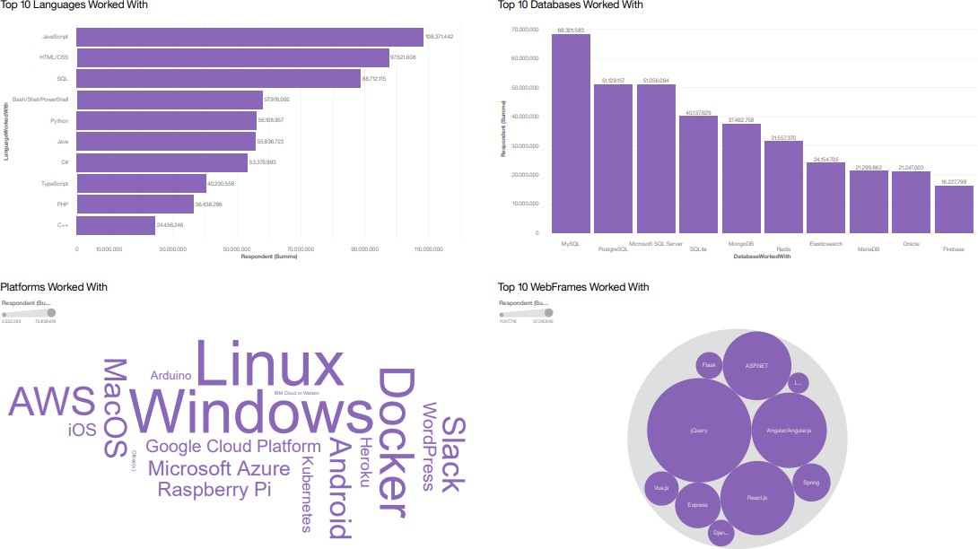
Dashboard Tab 1 – Current Technology Usage

Slide 14
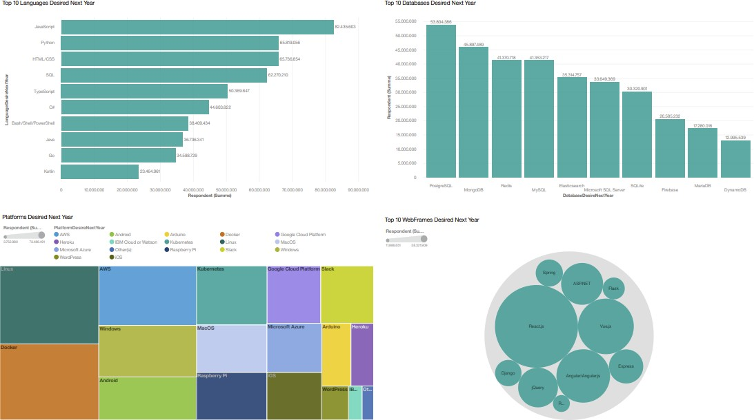
Dashboard Tab 2 – Future Technology Trends

Slide 15
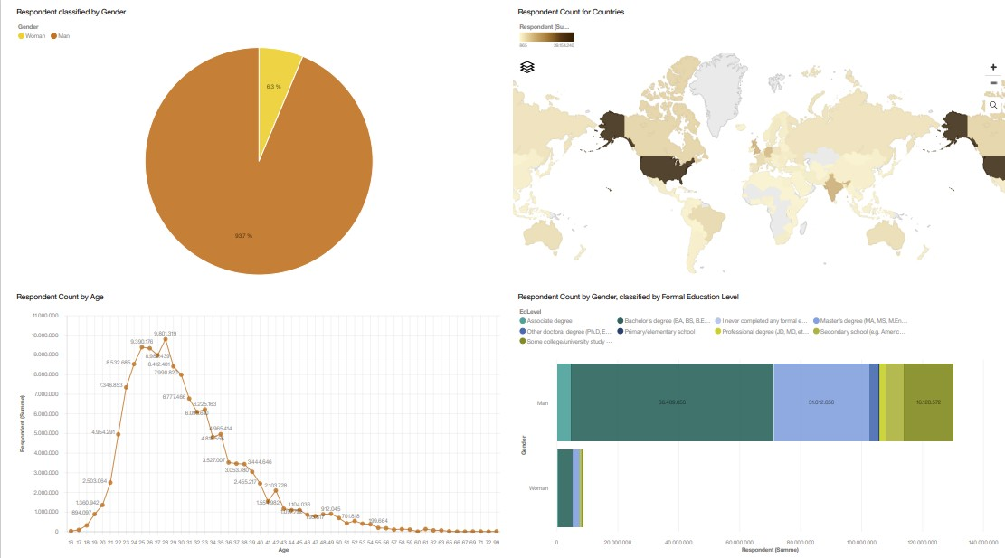
Dashboard Tab 3 – Demographics

Slide 16
1
Weighing costs and benefits
All results should serve as a guideline. Learning a new programming language or database application is time consuming and should be in proportion with the expected profit, e.g., higher earnings.
Additionally, the further development from the report is not yet foreseeable. In 2022, there could be new changes due to a rapidly changing programming world.
Discussion

Slide 17
OVERALL FINDINGS & IMPLICATIONS
1
2
3
4
Focus on JavaScript & Python
Learn how to work well with PostgreSQL and MongoDB
Linux, Windows, Docker & AWS as Platforms
React.js & Vue.js as growing WebFrames
As a first choice, developers should focus on JavaScript and Python as growing programming languages.
Comparing 2019 to 2020, jQuery becomes less important as a WebFrame.
Instead, developers should focus on React.js, Vue.js, and Angular.
As a first choice, developers should focus on PostgreSQL and MongoDB as Databases to work with as these are fast growing.
Comparing 2019 and 2020 Linux, Docker, AWS and Windows remain relatively stable as the most popular platforms. Developers should know how to use them.

Slide 18
CONCLUSION
Changing Requirements
Top skills in demand will show up in 2020 due to changing requirements in the areas of programming languages, databases, platforms and WebFrames, among others.
Use the results as a guideline
Developers should know the trends and follow the top demands.
If they specialize in a completely new language, it is important to weigh the costs and benefits (such as higher earnings).
After all, it is possible that the top skills in demand will shift again in the coming years.
Current Top Languages & Databases
The results show that Python is the fastest growing programming language. Also, Python is the second best paid after Swift (see appendix). Since Javascript is still in first place, developers should continue their education in both languages As databases developers should focus on focus on PostgreSQL and MongoDB as Databases to work with as these are fast growing.
1
4
2
3
Current Top Platforms & WebFrames
Linux, Docker, AWS and Windows remain in high demand in 2020. As WebFrames, developers should be able to use React.js and Vue.js, Angular remains important, while jQuery's popularity is waning.

Slide 19
Relevant Sources
Sources used
1
GitHub Jobs & Most Paid Languages
Findings from Module 1
2
Appendix

Slide 20
Relevant Sources
Popular Programming Languages. URL https://cf-courses-data.s3.us.cloud-object-storage.appdomain.cloud/IBM- DA0321EN-SkillsNetwork/labs/datasets/Programming_Languages.html
Stack Overlow, 2019. URL https://insights.stackoverflow.com/survey/2019

Slide 21
GitHub Job Postings
JavaScript
Java Python
Scala
C
C++
SQL Server PostgreSQL MongoDB
C
Orcale
0
25
50
75
Number of job postings

Slide 22
The 5 Most Paid Programming Languages
Swift
Python
C++
JavaScript
Java
$0
$50.000
$100.000
$150.000
Annual earnings in dollars

